Slide 1
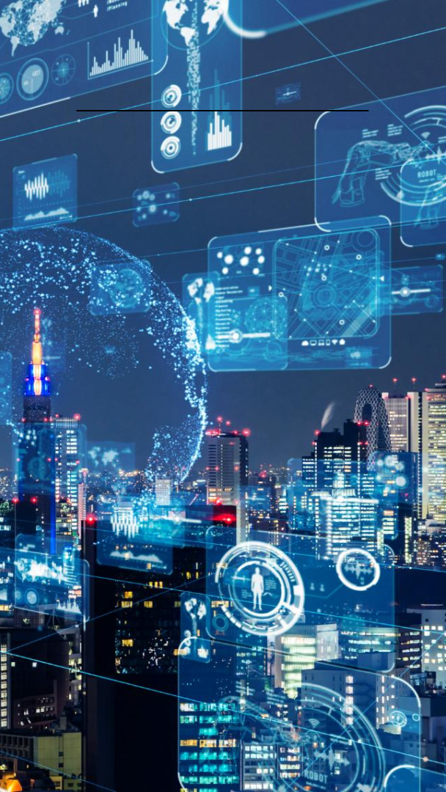
What is Machine Learning?
Machine Learning is a type of Artificial Intelligence (AI) that allows computers to learn from data without explicit programming. In other words, machine learning algorithms can recognize patterns and make predictions based on data, without getting a command. This enables computers to learn new tasks and improve their performance over time without human intervention.
Where is Machine Learning used?
Machine learning is in use by a wide range of applications, including email filtering, Social Media Personalization, Image Recognition, Speech Recognition, fraud detection, Text prediction, Product recommendation, medical diagnosis, Healthcare Personalization, Traffic Prediction.

Slide 2
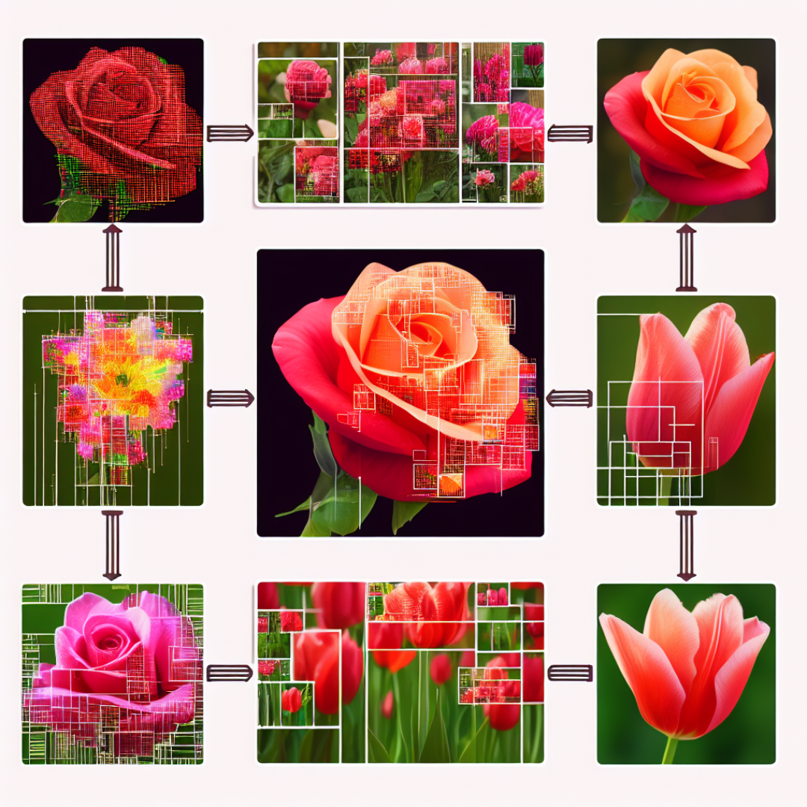
Unveiling the Magic of Machine Learning: A Basic Illustration
Imagine that you have created a machine learning algorithm to differentiate between two types of flowers in images. You would start by providing the algorithm with a dataset of images which you label as either a "Rose" or "Tulip".
The algorithm would then learn to recognize the patterns in these images that are associated with each label. Once the algorithm has been trained, you can evaluate it by giving it a new image that it has never seen before. The algorithm will then use the patterns it has learned to predict whether the image has a rose or a tulip.

